Slide 1
Cell application pack
For the CELL Organisation

Slide 2
Job Opportunities
Wanted - cells that are specialised for different jobs within our organism a.k.a. the CELL Organisation
We need:
Sperm cells, Egg cells, Red blood cells, Fat cells, Nerve cells*, Ciliated cells* and Cone cells*
(Our sister company is looking for Root Hair cells)
* Associated with a higher salary

Slide 3
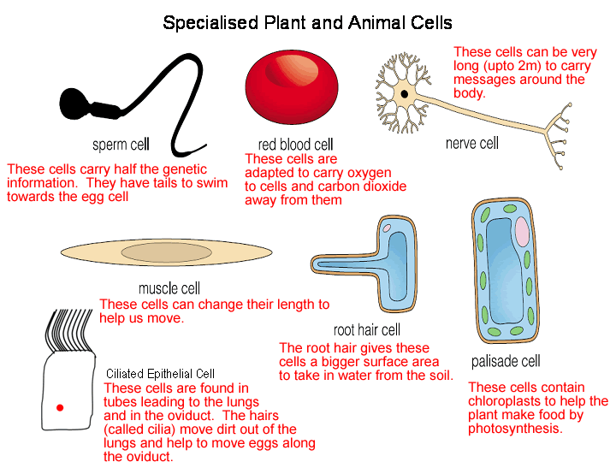
Reminder

Slide 4
How to apply
Please send us your C.V. including information on what makes you the best cell for the job!

Slide 5
Example from Samuel Perm
Dear Sir or Madam,
I am applying for the position of a sperm cell.
I am a really enthusiastic worker and full of energy as I have lots of mitochondria.
I have excellent swimming skills due to my flagella, which would help me on my journey to the egg.
I have a relatively big nucleus that contains lots of genetic material from my dad.
I have to admit that I have a criminal past. I used to use my acrosome to break into things but I have turned a new page and want to use the enzymes inside it to break into egg cells.
Please consider me for the job,
Samuel Perm

